Slide 1

Network Growth and Process Optimization
Growth
Wins
Strategic Initiatives
Customer Anecdotes
Q1 2022 – All Hands | Courtney Judson

Slide 2
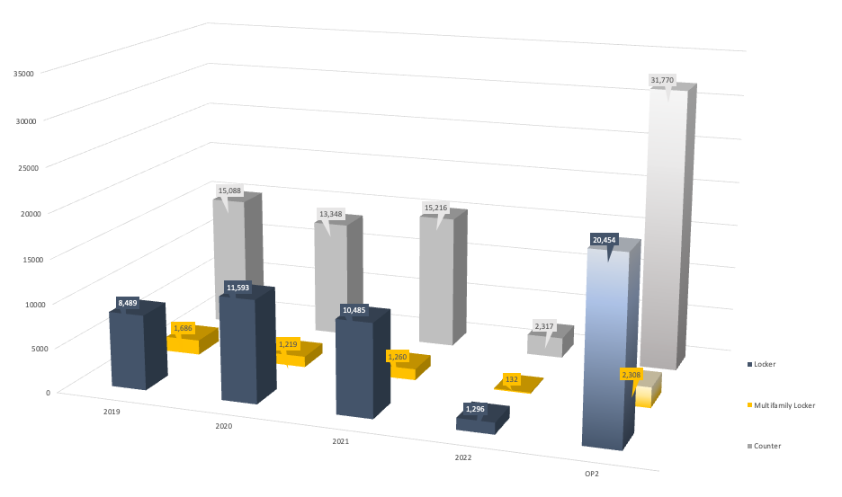
WW Hub Activations by Year
2015 – 2022 + OP2 Forecast
Notes:
Look at our incredible growth! This was made possible by the strong collaboration across global BD, AM and Ops organizations but also by a team of operators who work tirelessly day in and day out. I’d like to give everyone a peak behind the scenes to show you what it takes to scale and manage our massive physical network, starting with Geoff who gracefully and successfully navigated a global supply chain crisis.
Turning over to you Geoff!

Slide 3
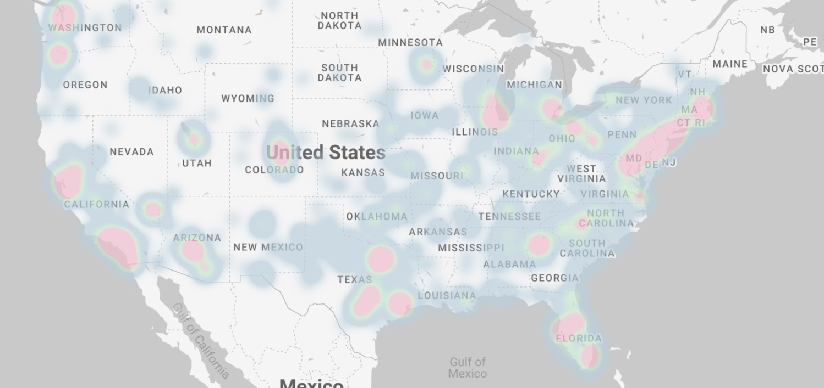
Hub Coverage
United States
United States Access Points
Locker
Apt Locker
Counter
USA
CA
MX
13,981
552
233
5,793
-
-
5,418
369
988
Notes:
MATT TO UPDATE WITH HIS CONTENT

Slide 4
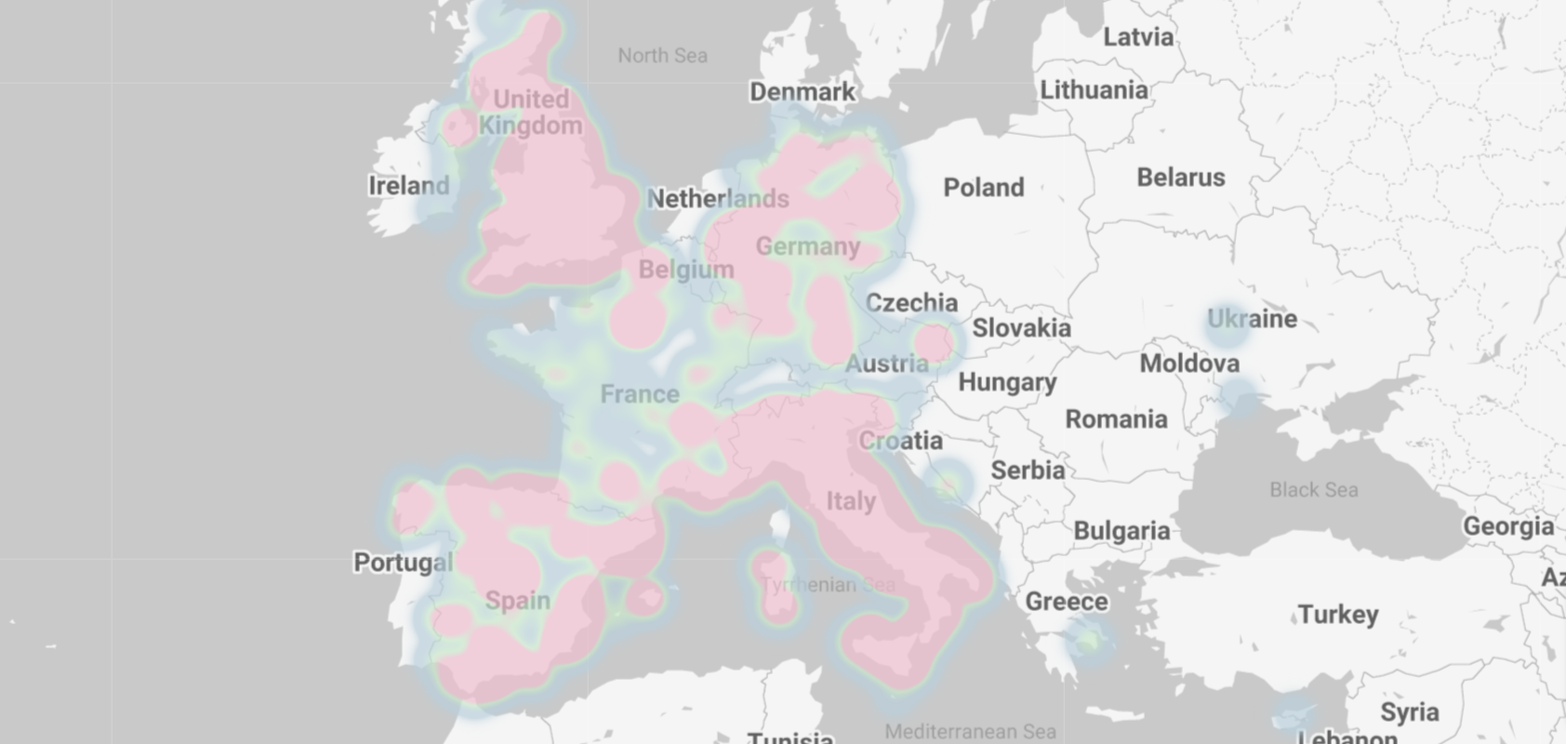
Hub Coverage
European Union
Countries
Locker
Apt Locker
Counter
AE
DE
ES
FR
GB
IT
AT
CZ
LU
PL
16
3,592
2,292
3,338
5,895
3,659
246
1
2
5
-
38
48
561
160
3,763
542
8,908
10,108
Notes:
MATT TO UPDATE WITH HIS CONTENT

Slide 5

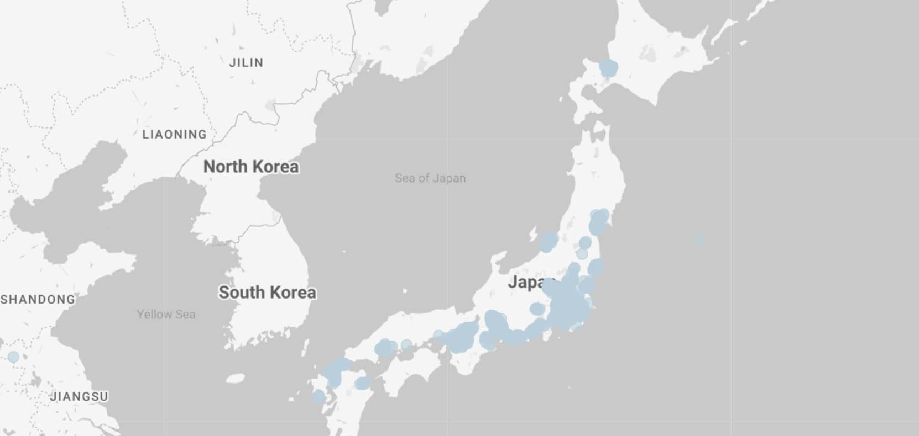
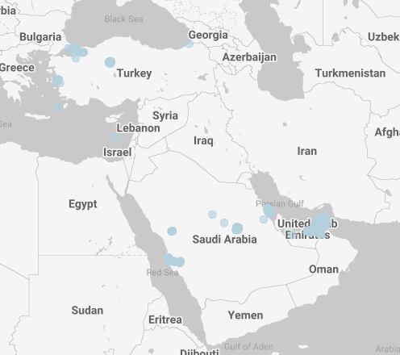
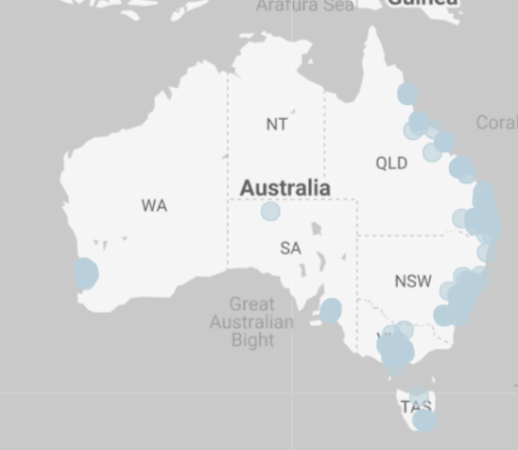
Hub Coverage
MENA & APAC
APAC
MENA
Locker
Counter
TR
SA
-
-
97
311
Locker
Counter
JP
AU
2,475
481
139
406
Notes:
MATT TO UPDATE WITH HIS CONTENT

Slide 6


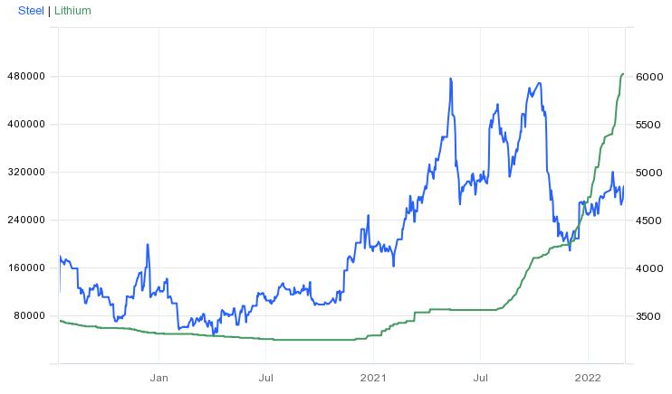
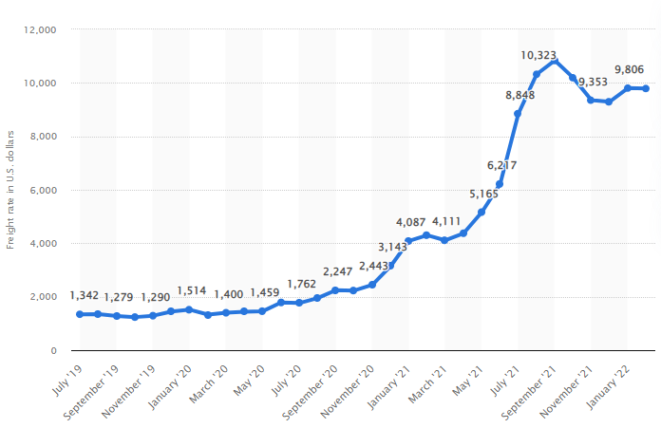
Global Supply Chain
How Did We Do It?
Dedicated PAS for Long-Lead Time Components
Creative Logistics Solutions
Final Assembly at Local Warehouses
Open Market Component Purchases
Tier II and Tier III Vendor Management
Dedicated Headcount in China
Steel & Lithium Prices
Freight Prices

Slide 7
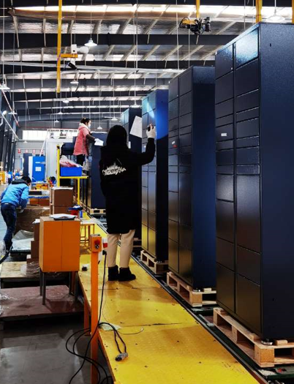
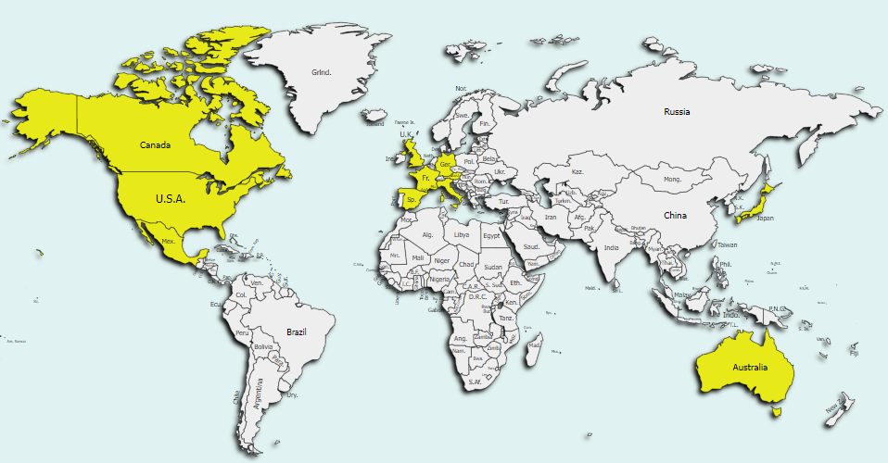
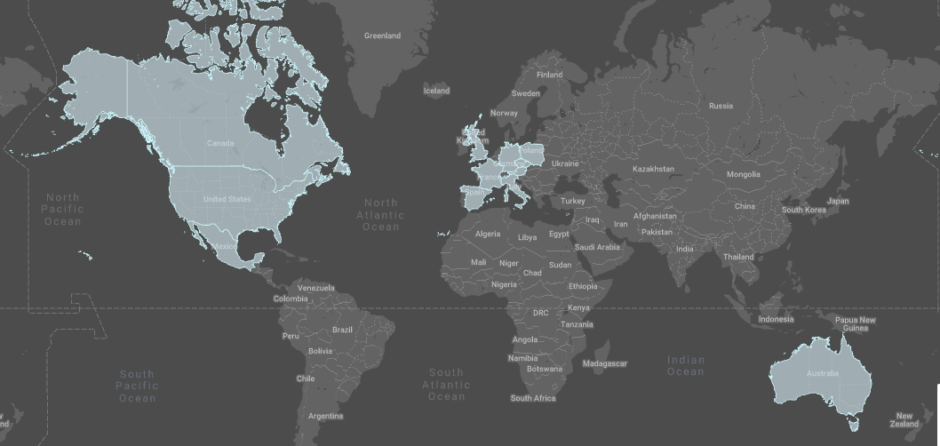





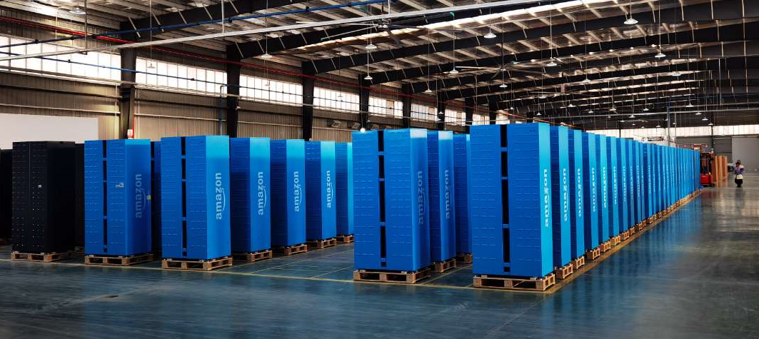
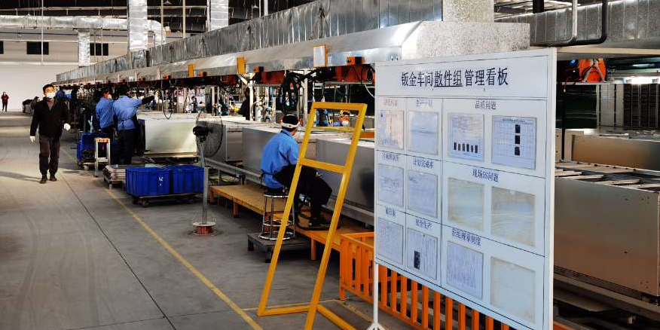
Global Supply Chain
Over 40k Odin Lockers Have Shipped to 11 Countries

Slide 8
Onboarding, Installation & Network Management
2021 Highlights
Location Onboarding
Network Management
[NA] NPS (Lkr + Apt Lkr) score of 62.90!
[JP] More than doubled its network (1.1k to 2.2k lockers) with a 4 member team + launched Odin!
[CA] The first year Canada Locker met its network expansion goal!
[FR] Franprix installed 120 Lockers in 3 just months!
[US & CA] Controllable onboarding cycle time reached lowest ever rate of 38.73 days
[US] Apt Lkr = 88.3% RDA adoption
[DE] Netto (supermarket chain) roll-out with 297 installations representing 8.4% of total locker fleet.
[WW] Strong network uptime in 2021
NA Locker: 99.45%
NA Apt Lkr: 99.27%
MX Locker: 99.43%
CA Locker: 99.36%
EU Locker: 99.53%
AU Locker: 99.4%
JP Locker:
[WW] Text to Kiosk: vendors can request provisioning codes and locker health checks via SMS text messaging
[WW] Google pin integration
[US] eSIM migration to fully eliminate Hub dependencies on single source carriers
[EU] Migration of 3P partners from an obsolete/unsecure technology to the API and Web App integration.
[AU] Launched same-day ship option parity
[MX] Telcel migration to 1NCE, driving an -80% reduction in monthly cell phone fees per locker.
[JP] Introduced fall prevention boards
Notes:
Thanks, Geoff – port congestion is one of my favorite topics! But the fun doesn’t stop there! As most on this call are aware, the effort to deploy and maintain our fleet is no small feat!
In addition to managing thousands of installations each year, plus tens of thousands of installed locations, each member of Partner Ops is also responsible for driving key projects that increase our scaling velocity, minimize defects or delight our Partners. I’m so proud of the team for their many wins in 2021. A few are shown on the screen - if I listed them all, we’d likely be sitting here for days.

Slide 9

Partner Onboarding
NPS Responses
“It was a quick and easy process. The amazon surveyor did a thorough job and was very receptive to questions. Everything was perfect.” - Locker (US) 27/01/2022
“Rep was thorough, knowledgeable, efficient and on time!” - Apt Lkr (US) 11/01/2022
“On-site technician Friendly and professional” -SVAR San Severo (IT) 24/02/2022
“Technician polite and friendly”- La Fenice Servizi Niscemi (IT) 28/02/2022
“Technician professional and friendly” - Nils-Holger Meyer e.K. - Emden - Ringstr. (DE)14/02/2022

Slide 10
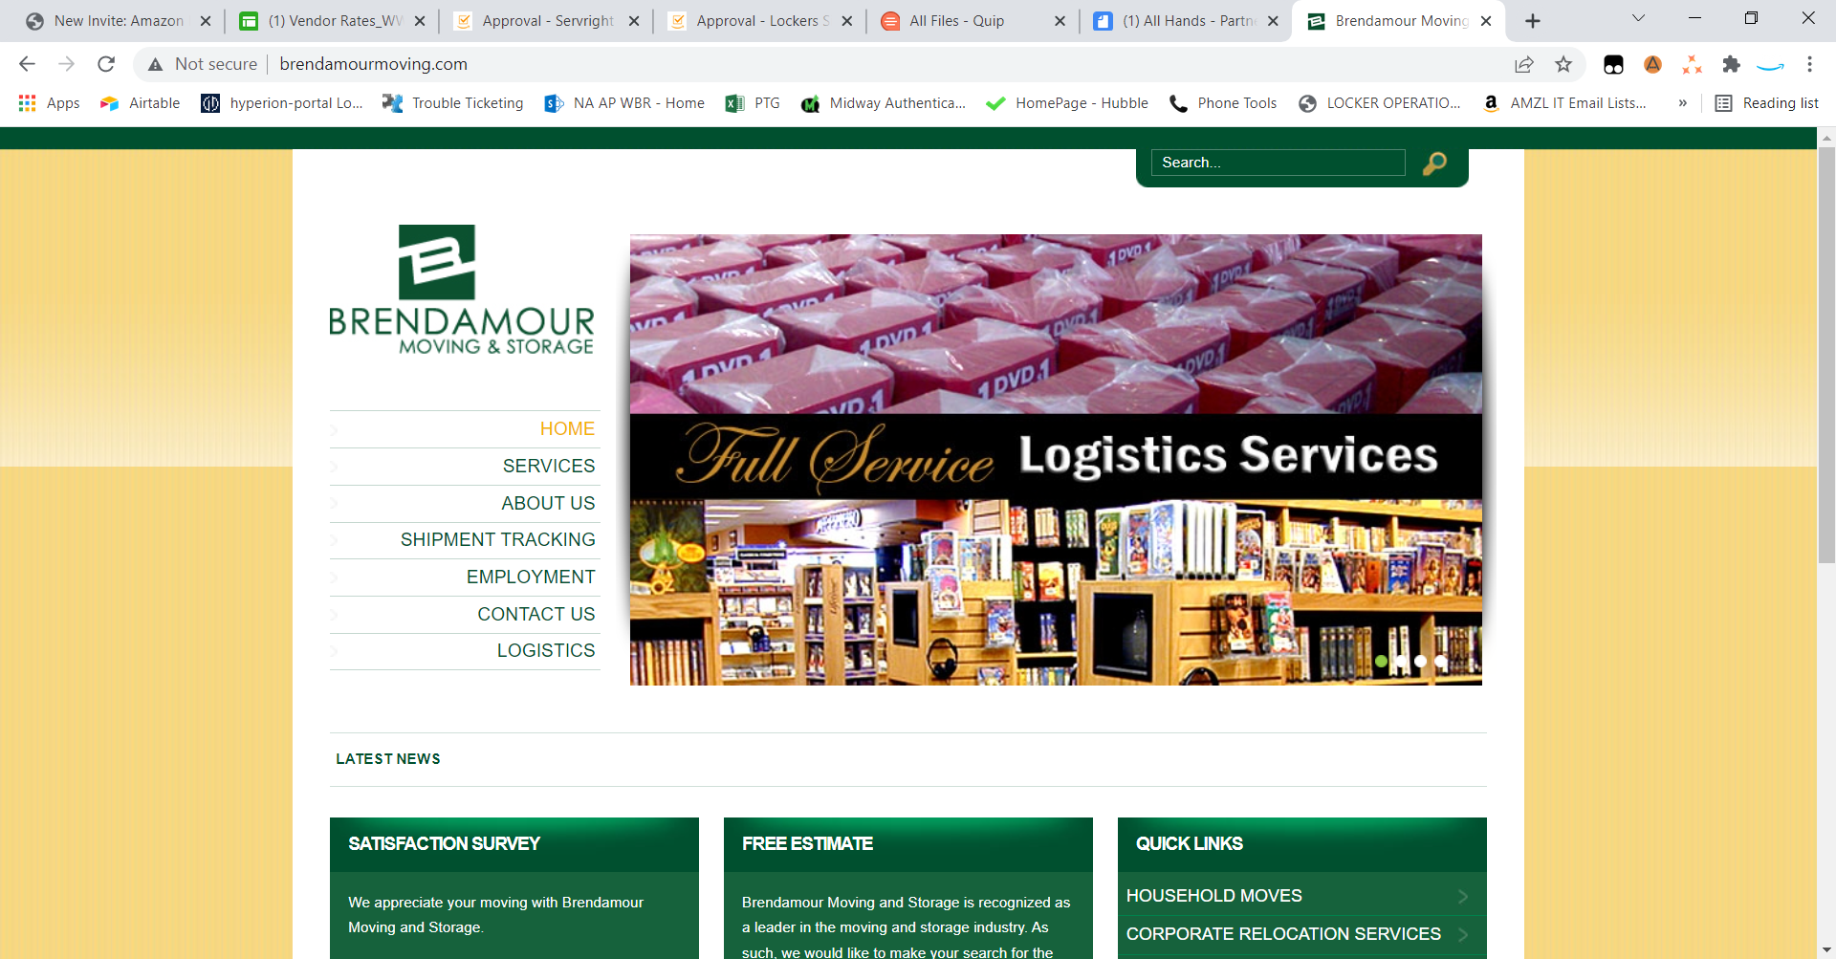
















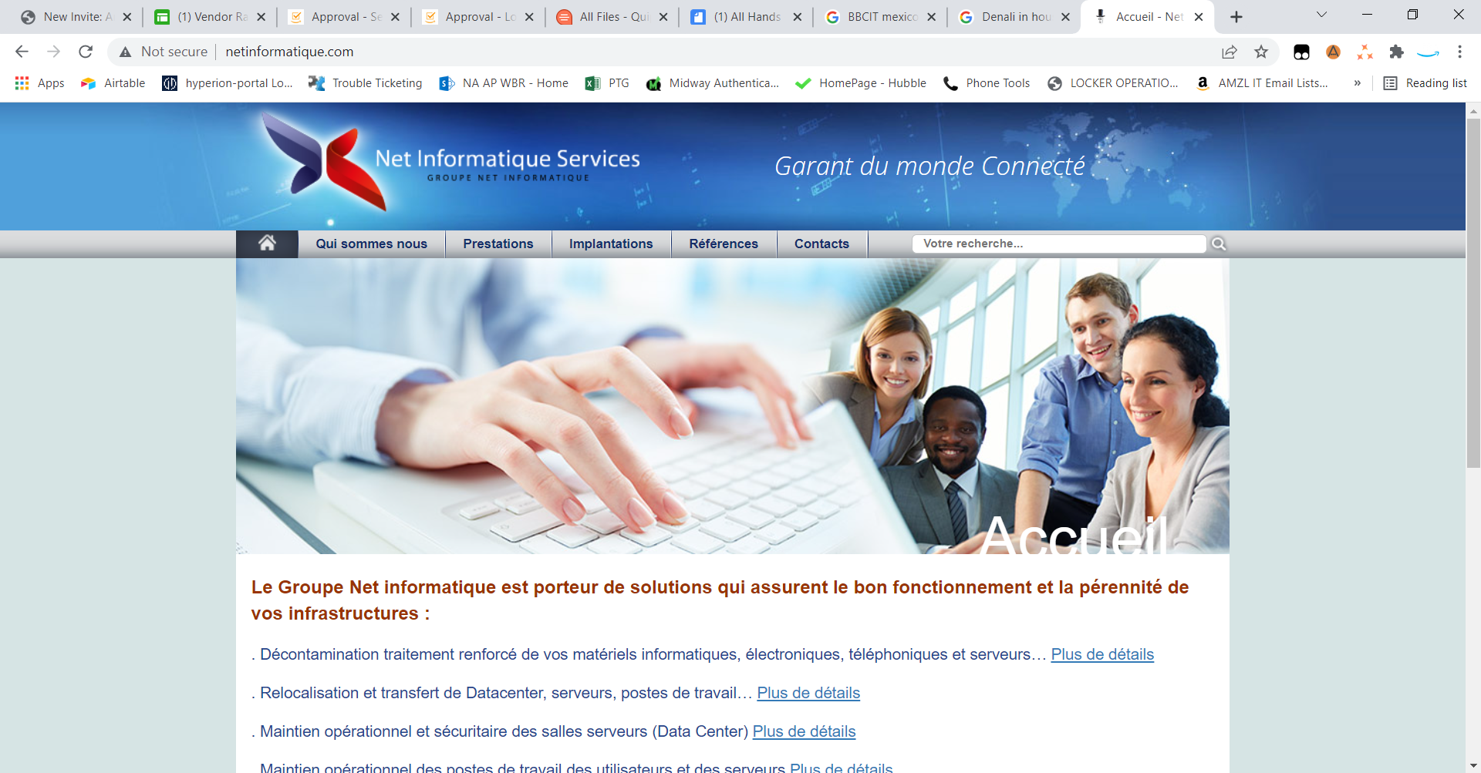




3P Supplier Management
Global Supply Chain
To expand and maintain our network we leverage relationships with suppliers acrpss the globe
Eliminate single sourced points of failure
Optimize SLAs and performance KPIs (i.e. DTTR, lead times)
Minimize defects (i.e. damaged hardware)
Reduce costs!

Slide 11
Key Cost Savings Initiatives
New & Renegotiated Contracts
Vendor
Details
Why this is a win…
Telefonica
This new agreement will replace existing contract with Vodafone, aiming to complete migration by the end of Q1 2021.
The new monthly estimated cost per locker is EUR3.00 against current cost of EUR25.73. This equates to a monthly saving per locker of €22.73 (88%). Annual estimated costs and savings for 15,105 lockers are €544K and €4.1MM. The positive NPV value for 2 years (2021/22) is EUR6.4MM, accounting for migration costs and impact on Counter devices (EUR1.1MM).
T-Mobile
With the merger of Sprint to T-Mobile, we were able to renegotiate new pricing on both 12,292 preexisting and new lines going forward.
Terms also included the ability to switch to e-SIMs.
Based upon 12,822 Sprints SIMs, new billing reflects -66% MoM. MoM savings of approx. $109K per month or $1.308M annually ($2.6M over 2-yr)
Long term benefits of e-SIM: 1) We can switch between partner profiles (Verizon, AT&T, T-Mobile) over the air 2) no longer require a physical visit to swap out carriers and 3) Minimize the expense of modem configuration. T-Mobile will absorb the $1.5M expense associated with physical SIM swap.
ServRight
Signed second vendor for provisioning and maintenance services in Canada.
We now have a primary vendor in Canada and have doubled provisioning and maintenance capacity. Ensures we have contingency vendor for provisioning and maintenance in CA.
NSA
Onboarding of new survey vendor.
We have established liquidated damages against SLAs. Doubled vendor capacity in the US and Canada, and decreased average cost of surveys (Apt. & Lkr) from $190 to $173. Estimated decrease in spend by 8% or $670K annually ($1.34M life of contracts).
Bureau Veritas
Onboarding of a second survey vendor.
AT&T
Amazon Hub has partnered with AMZ Rivian account via regional procurement. To lower cost by 84.63% .
Estimated spend -84.63%, from $17.57 per to $2.70 per month/per SIM (based upon 1.5 GB usage) or $168K annually.
Notes:
Strategic initiatives to improve scaling velocity:
Salesforce
3P vendor projects

Slide 12
AMAZON HUB
In the works for 2022
Install|Fleet Management
Misc. Vendor Initiatives
Connectivity Carriers
RICOH
WO Renegotiation securing an alignment on SLA of 95% and a path for 99% for same day resolution.(MX & EU)
AMXL
VERIZON
REDBOX
Onboarding and pilot of install with an AMXL sap (target -60/70% on install cost for M indoor). (DE/UK/ES/IT)
WO Renegotiation of carrier services for current and future locker lines. (US)
intervention)
VERIZON
CARDTRONICS
REDBOX
CENTRAL warehousing
Central warehouse in order to decrease cost and increase flexibility across installation vendors. Target reduction of 50% for pallet monthly storage cost. (UK/DE/ES)
CENTRAL warehousing
CARDTRONICS
Centralize added services (such RMA) that will reduce spend on modem configuration.(US)
SIM Card Vendor Change
Change of SIM card provider to 1nce. Target- 85% savings over current Telefonica rates. (MX & AU)
BBCIT
New vendor agreement that targets reduction in survey/install spend by 5% and formally ads continency vendor. (MX)
NEW Permit Vendor
Onboarding of new permit service provider in IT (capacity) and AT (cost decrease). (EU)
CARD TRONICS
Renegotiation w/ survey/ Install/maintenance vendor to streamline operational processes (AU)
Notes:
No changes

Slide 13











Salesforce
Wins & Key Initiatives
Primary Tools
2021 Wins
Built a SF team with net new functions: + TPM, + SF Admins, + Architect, +QA and doubled engineering team
Quick reprioritization to unblock business priorities: Dobby launch and Apt Lkr Capacity (Level Up)
2022 Initiatives:
Onboard second integration services to hedge developer retention issues in India
Deliver global parity: Lead and prospecting management, Locker onboarding, supplier integration, reporting
Geographic Analysis Tools
Onboarding Tools
Communications Tools
Analytics Tools
Notes:
NOTE – There are a number of tools that we can deprecate with Salesforce launch

Slide 14
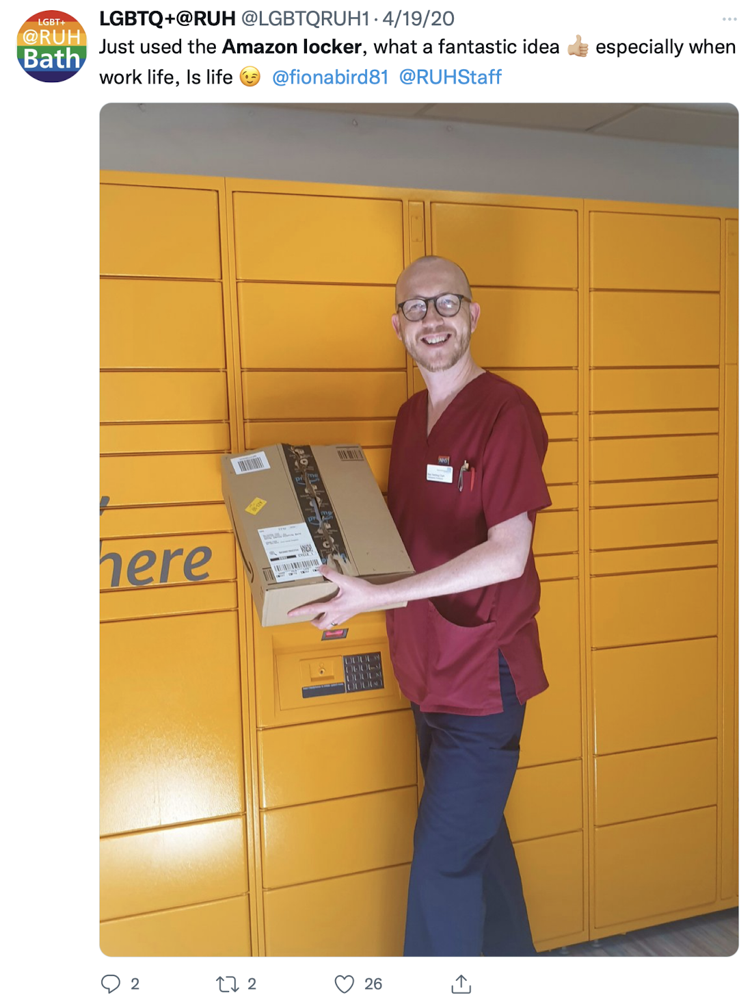



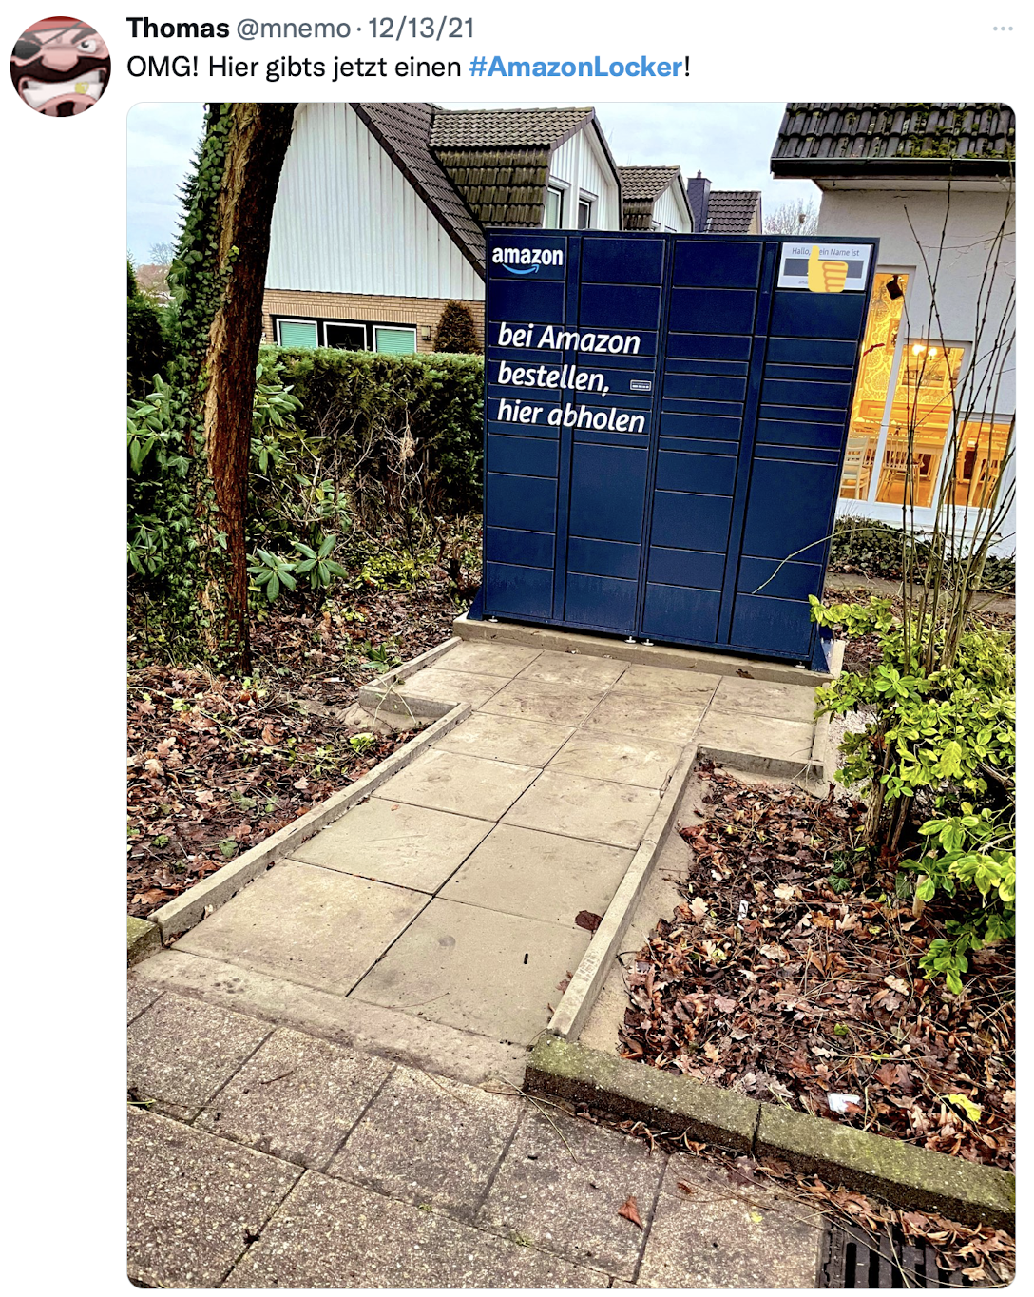
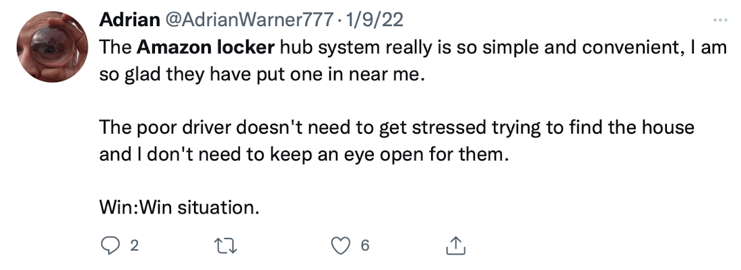
Social Media
The Good Stuff
Notes:
Nurse – date was 4/19/20 at the beginning of the pandemic

Slide 15
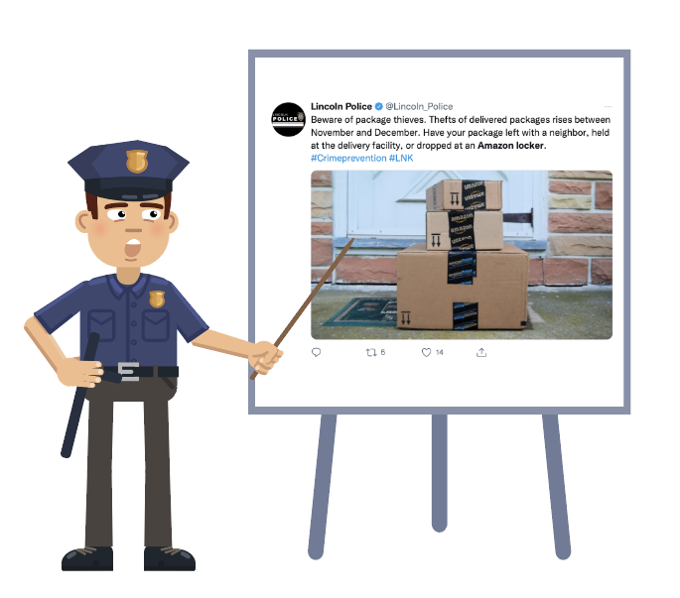

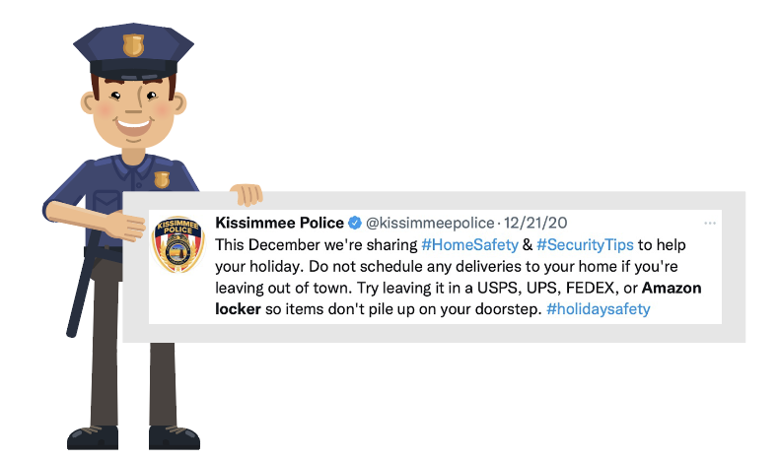
Social Media
Crime Stoppers
Use a Locker!!!
Notes:
Nurse – date was 4/19/20 at the beginning of the pandemic

